Slide 1

Email Spam Classifier Project Report
With the ever-increasing digital communication, spam emails have become a significant concern, leading to security threats, phishing attacks, and loss of productivity. This project implements an intelligent and automated solution using Machine Learning techniques to classify emails as 'Spam' or 'Not Spam'.
The system provides an efficient and user-friendly environment where any user can paste an email and instantly get a classification result. The interface is designed using Streamlit to make the tool accessible and interactive.
AA
by Aditya Agarwal

Slide 2
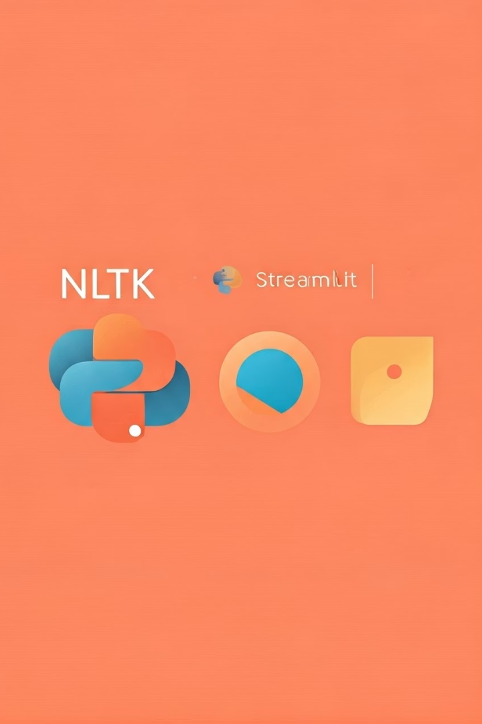
Technologies Used
Core Technologies
NLP Tools
Python serves as the core programming language for logic, ML training, and backend integration. Streamlit provides a lightweight framework for building fast and interactive web applications.
NLTK (Natural Language Toolkit) is used for tokenization, stopword removal, and stemming, providing robust NLP tools essential for text preprocessing.
ML & Development
Scikit-learn enables model training, evaluation, and vectorization using TF-IDF. Jupyter Notebook facilitates code development, experimentation, and visualization.

Slide 3
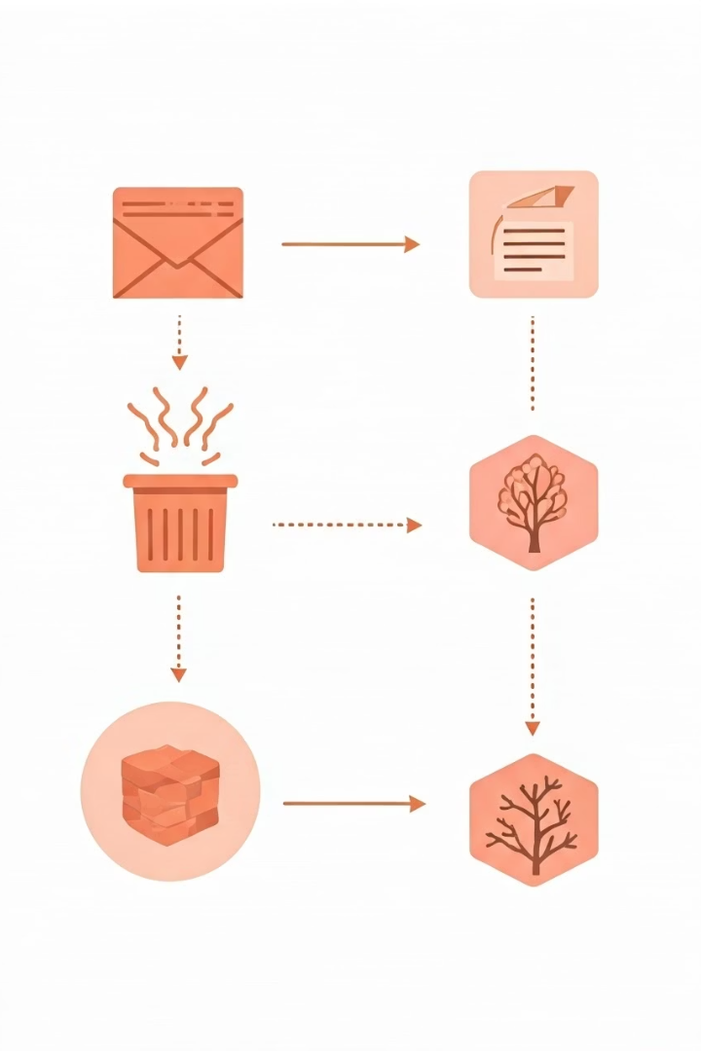
Text Preprocessing in NLP
Initial Text Cleaning
All text is converted to lowercase to reduce dimensionality. For example, 'Free' and 'free' are treated the same. Special characters and digits are removed using isalnum() to focus on meaningful words.
Tokenization & Filtering
Email content is split into individual words using TreebankWordTokenizer, which handles contractions and punctuation well. Commonly used English words (e.g., 'the', 'is', 'in') are removed using NLTK's stopwords list.
Word Normalization
PorterStemmer reduces words to their root form (e.g., 'running', 'runs', 'ran' → 'run'), reducing complexity and standardizing word usage for more effective classification.

Slide 4






Machine Learning Models Evaluated
Tree-Based Models
Random Forest showed high accuracy but higher computational cost. Decision Trees were simple but prone to overfitting.
Naive Bayes Variants
Gaussian, Multinomial, and Bernoulli Naive Bayes were tested, with Bernoulli performing best for binary features.
Linear Models
Support Vector Classifier works well in high-dimensional space. Logistic Regression performed well but slightly underperformed BernoulliNB.

Slide 5
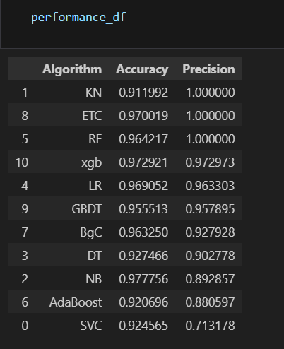




Why Bernoulli Naive Bayes Performed Best
Binary Feature Alignment
Bernoulli Naive Bayes assumes binary features, which align closely with the TF-IDF representation of emails (word exists vs. not exists).
Computational Efficiency
Its simplicity and low computation time made it ideal for real-time classification of incoming emails.
Word Absence Significance
This model is especially effective in scenarios where absence of a word is as important as its presence in determining spam.
Research-Backed Performance
Academic research supports its effectiveness in binary text classification tasks like spam detection.

Slide 6


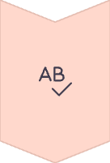

Current Model Limitations
Word-Level Focus
Preprocessing Simplicity
Over-reliance on word presence without handling contextual or semantic meaning of text.
Stemming can remove necessary word distinctions
that might be important for classification.
No Context Understanding
Fixed Vocabulary
Cannot detect advanced spam with hidden meanings or image-based content.
Unknown words encountered during inference
are ignored, limiting adaptability.

Slide 7





Future Enhancements
Advanced NLP
Implement lemmatization instead of stemming to better retain semantic meaning. Add multilingual support for broader coverage of spam emails.
Deep Learning
Integrate transformer models like BERT or RoBERTa for deeper contextual understanding of messages.
Continuous Learning
Incorporate active learning with user feedback to update and improve the model continuously.
Better Representations
Use word embeddings like Word2Vec or GloVe instead of TF-IDF for improved text representation.

Slide 8
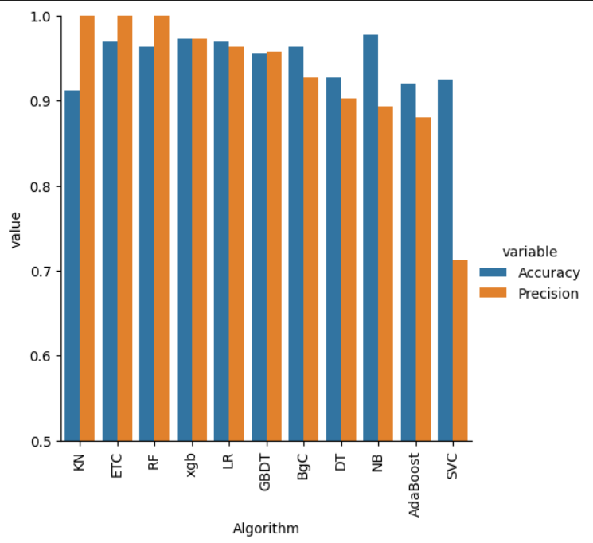
Model Performance Comparison
Random Forest and Logistic Regression also showed strong performance but with higher computational requirements. Gaussian Naive Bayes performed poorly, confirming it's not suitable for text classification tasks with sparse feature representation.

